Slide 1
Chemical Engineering Thermodynamics
CHE 3062
Class meets MTWR from 12:20 to 1:15 Swift 809
Help Sessions:
Wednesday 3 to 5 pm ERC 425 and 6 to 9 pm ERC 405
Prof. Greg Beaucage
beaucag@uc.edu
http://www.eng.uc.edu/~beaucag/Classes/ChEThermoBeaucage.html
Kiet Pham (Undergraduate)
phamke@mail.uc.edu
ERC 460
Introductory Chemical Engineering Thermodynamics Second Edition
J. Richard Elliott and Carl T. Lira
ISBN 978-0-13-606854-9http://chethermo.net/

Slide 2
Chemical Engineering Thermodynamics
Course Logistics
Quizzes: Weekly quiz composed of questions similar to homework and example problems.
~Every Thursday
Group Homework: Weekly Group Homework. We will go through homework in a work session Wednesday in Class.
~Help Sessions Every Wednesday and 6 to 9 pm ERC 405 (Kiet and Me.)
Homework is due Wednesday night at midnight.
(You can use a smart phone app like “instapdf” to make a pdf of the homework.)
Weekly Assessment is due Monday by midnight.
Final: Comprehensive Final composed of questions from weekly quizzes. (Weighted as 8 quizzes.) A 90.0 natural average in the quizzes skips the final.
Grade is: 85% Average of Final and Quizzes and
10% Homework due Wednesdays at midnight
5% Weekly Evaluation (Self and course critique) Mondays at midnight

Slide 3
Chemical Engineering Thermodynamics
Course Logistics
Final letter grades will be based on class grade using the following scale:
A is between 90.0 and 100.0;
B is between 80.0 and 89.9;
C is between 70.0 and 79.9;
D is between 60.0 and 69.
Only whole grades will be given, i.e. the grade is B for 80 or 89.
Those with a "natural" 90.0 or above from quiz grades before the final do not need to take the final.
The comprehensive final is worth eight quiz grades.

Slide 4
Homework Groups
Randomly assigned on Mondays 7 groups of 4
First Homework is due Wednesday January 13 at midnight.

Slide 5
Plant Tours (No tours Spring 2021 due to Covid)
We will have non-mandatory plant tours.
The purpose is to see some of the processes we will study.
Attendance at a plant tour counts for 50 replacement points on a quiz. For instance, if your low grade is 30/100 this becomes a 65/100.
If you arrange a plant tour for the class you get 100 quiz replacement points.
Tours do not count for the final.
The timing for plant tours is variable.
Friday afternoon at 12:30 is a good time for me.
The tours can cover a maximum of 500 quiz points (five quizzes).

Slide 6
Recent Plant Tours
Miller Brewery (near Dayton)
Nease (Harrison)
Shepherd Catalysts (Norwood)
Steam Plant West Campus
Steam Plant East Campus
Kraus Maffei (Covington)
Este Oleo Chemicals (Ivorydale)
80 Acres Farm (Ivorydale/Hamilton)
Greater Cincinnati Water Works
Rheingeist Brewery

Slide 7
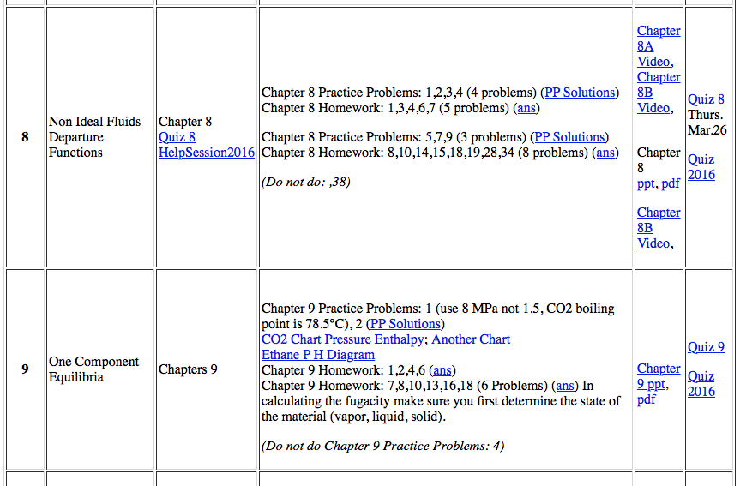
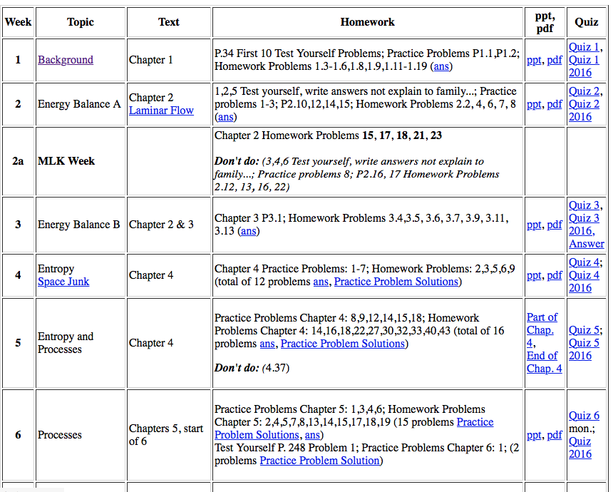
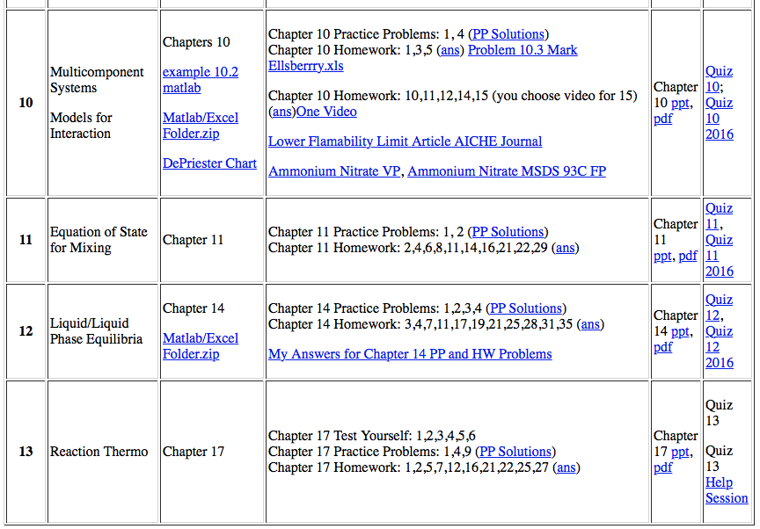
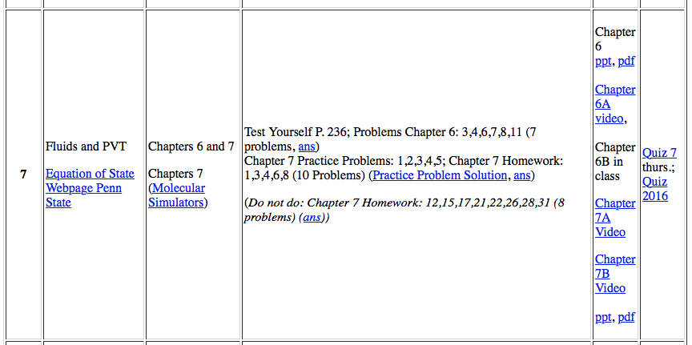
Outline of Class:

Slide 8
Chapter 1 Background
Energy is the capacity to do work.
Potential, kinetic, molecular, bond, nuclear, magnetic, Coulombic.
You use energy to do work. You can store energy or expend energy. You do work.
Work is the integral of force times change in distance.
Surface Energy, it requires energy to make a surface.
Kinetic energy of a monoatomic gas atom E = 3/2 k_{B}T.
(T is in absolute units otherwise we could have negative kinetic energy.)

Slide 9
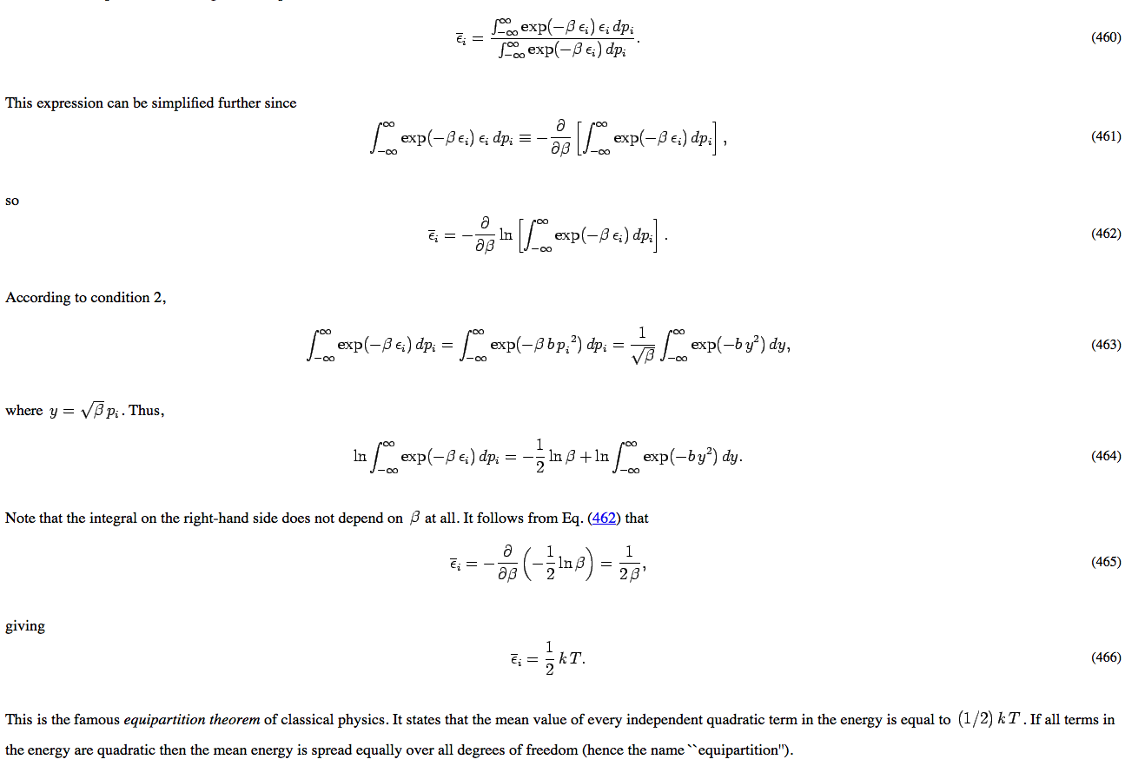
http://farside.ph.utexas.edu/teaching/sm1/lectures/node67.html

Slide 10
Ground state for energy.
We could consider T = 0 but this is inconvenient (impossible to achieve) and ignores atomic energy, E = mc², and chemical bond energy.
Often we define the ground state at STP.
In the end we are only interested in changes in energy for an event or process so the ground state is only important in so far as we use the same ground state for all components of a calculation.
First Law of Thermodynamics (basis of energy balance)
For any spontaneous process the total energy is constant. That is, in order for energy to increase we require work or heat to be added to the system.
E = PV for a gas,
to increase the pressure at constant number of gas atoms requires force and a change in distance, compression, that leads to a reduction in volume. Or you need to heat the system.

Slide 11
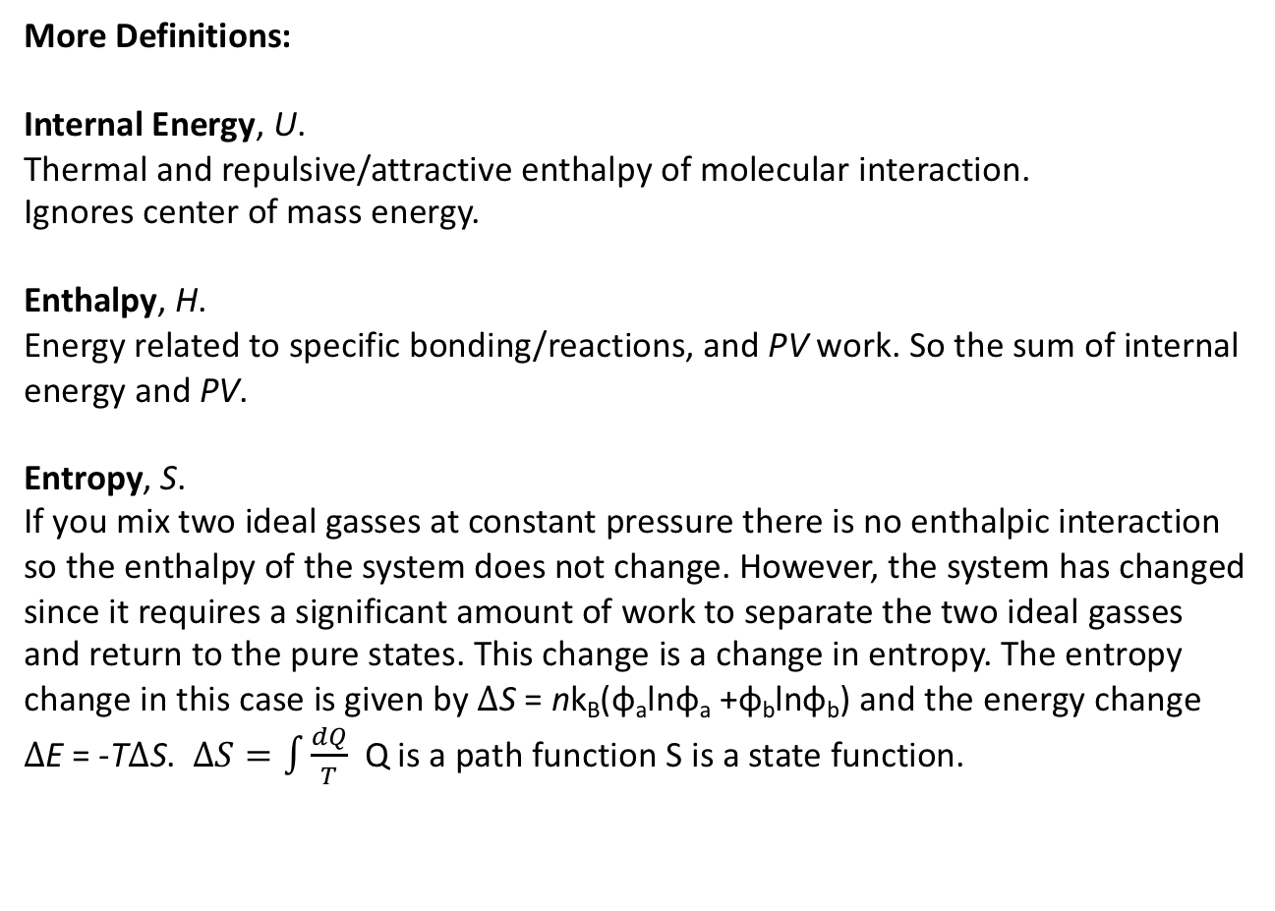
More Definitions:
Internal Energy, U.
Thermal and repulsive/attractive enthalpy of molecular interaction.
Ignores center of mass energy.
Enthalpy, H.
Energy related to specific bonding/reactions, and PV work. So the sum of internal energy and PV.
Entropy, S.
If you mix two ideal gasses at constant pressure there is no enthalpic interaction so the enthalpy of the system does not change. However, the system has changed since it requires a significant amount of work to separate the two ideal gasses and return to the pure states. This change is a change in entropy. The entropy change in this case is given by ΔS = nk_{B}(φ_{a}lnφ_{a} +φ_{b}lnφ_{b}) and the energy change ΔE = -TΔS. $∆S=\int{\frac{dQ}{T}}$ Q is a path function S is a state function.

Slide 12
More Definitions:
At a given temperature T
A “system” has
Kinetic energy associated with motion KE,
Potential energy associated with its position in a field (gravity) PE
Internal energy, U, associated with microscopic kinetic energies and the energy of interactions between microscopic components. The microscopic kinetic energy increases with temperature.
At absolute 0 the “system” has only one state, a perfect and infinite crystal. This condition is defined as having zero microscopic kinetic energy. At higher temperatures the “system” has more possible configurations, Ω. Boltzmann proposed that the number of states could be related to the energy of the system through a thermodynamic parameter, the entropy,
S = k_{B} ln Ω.
The entropy has a value of 0 at absolute 0 where only one state is possible. It increases with temperature and contributes –TΔS to the energy.

Slide 13
More Definitions:
Work is the change in energy for the “system”
W = ΔKE + ΔPE + ΔU
Mass added to the system results in a change in internal energy associate with the internal energy and potential energy of the mass transferred (uΔM) = ΔU
Heat, Q, flows from hot to cold. ΔU = Q

Slide 14
Philosophically How Thermodynamics Works:
We consider a subset of the universe called the system or the control volume. The system contains many molecular elements that are each subject to 3/2 k_{B}T kinetic energy. There are so many of these elementary units that they are almost uncountable. The most important step at the start of solving a problem in thermodynamics is to carefully define the system boundaries.
Closed System:
Thermal transfer but no mass transfer, say an ice cube melts into a puddle and the ice cube is the system.
Open System:
Mass and thermal transfer occurs, a system is a section of a river.
Isolated System:
No heat or mass transfer. A perfectly insulated box in which a match is lit.

Slide 15
Free Energy:
The energy that is available to do work.
Equilibrium:
A system is at equilibrium when the free energy is at a minimum. Two systems are at equilibrium with each other when every component of the two systems have the same chemical potential. (Dynamic equilibrium indicates that there are always fluctuations about an equilibrium composition due to thermal motion.)
The chemical potential is the change in free energy when one element (molecule or mole) of that component is introduced to the system.
Heat Sink/Heat Reservoir:
A component with infinite capacity to absorb or generate heat (transfer of thermal energy). The heat sink is at a constant temperature. That is, it is isothermal

Slide 16
Intensive Properties: (Not underlined, V)
Pressure, Temperature, Free Energy, Internal Energy, Specific Volume
Things that do not depend on system size.
State Properties:
These are intensive properties that specify the state of the system. This is F in the Gibbs Phase Rule. Changes in energy sum to 0 through a cyclic path. (Entropy, Enthalpy, Internal energy)
Path Dependent Properties:
Work and Heat. Changes in these do not sum to 0 through a cyclic path.
Extensive Properties: (Underlined in the book, V)
Volume, Mass, Total Energy
Things that are determined by the system size.

Slide 17
How is thermodynamic equilibrium achieved?
Thermodynamics assumes that large population of small objects, each of which has energy 3k_{B}T/2 and moves randomly by thermal diffusion, interact with each other and transfer energy. The system is random in space and time so that fluctuations in density and speed occur at random in space and time. These random thermal fluctuations allow the molecules to probe the conditions at higher and lower concentration, to compare the favorability of conditions at these different densities and to find the state with the lowest free energy.
Thermodynamics relies on random fluctuations in density, and molecular motion.
The first stage of considering random fluctuations is the kinetic theory of gasses

Slide 18
Ideal Gas Law
A gas is viewed as a collection of particles each with momentum p = mv in a box of size L.
The x-component of momentum is p_{x} = mv_{x}.
On collision with a wall the change in momentum is 2p_{x} for a wall normal to the x direction.
The particle impacts the wall every <Δt> = 2L/<v_{x}>.
The force is given by F=ma=Δp_{x}/Δt =Nm<v²_{x}>/L for N particles.
We have <v²_{x}>=<v²>/3 for random motions (x, y, and z are indistinguishable).
So, F = Nm<v²>/(3L) for 3d.
The pressure,P = F/L² = Nm<v²>/(3V).
We have m<v²>/2 = Kinetic Energy = 3k_{B}T/2.
So, PV = Nk_{B}T.

Slide 19
Ideal Gas Law
F=ma=m(dv/dt)=dp/dt
from before Δp is 2 p_{x} And Δt = 2L/v_{x}
So F = m<v_{x}^2>/L
For 3d and N atoms F = 1/3 N m <v²>/L
E = 3/2 kT = ½ m<v²>
So m<v²> = 3kT
P=F/A = 1/3 N m <v²>/(LA) = NkT/V

Slide 20
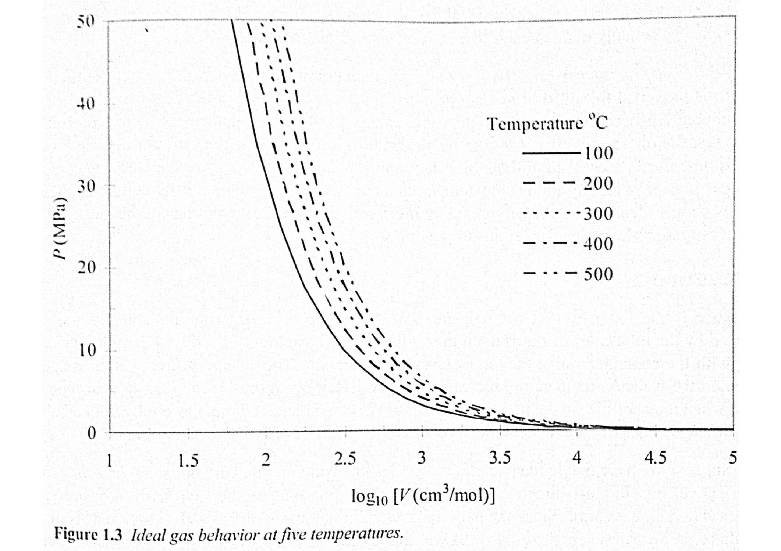

Slide 21
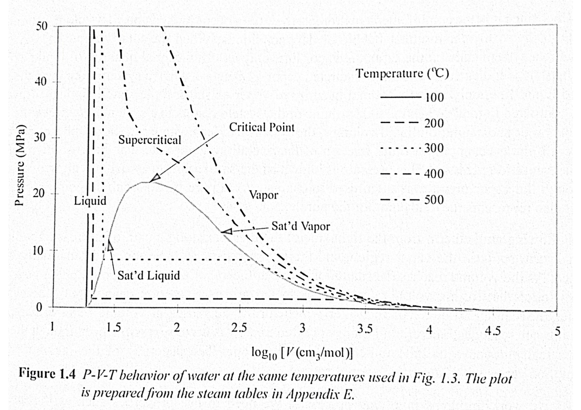

Slide 22
“Quality, q”
When a mixture of two phases (vapor/liquid) exist the fraction vapor is called the “quality”. The intrinsic properties (M) such as V, U, H, S can be calculated for a two phase single component system using the “quality” and the values for the saturated liquid and vapor phases:
M = (1-q) M^{L} + q M^{V}
or
M = M^{L} + q (ΔM) = M^{L} + q (M^{V}-M^{L})

Slide 23
http://ecoursesonline.iasri.res.in/mod/page/view.php?id=2406

Slide 24
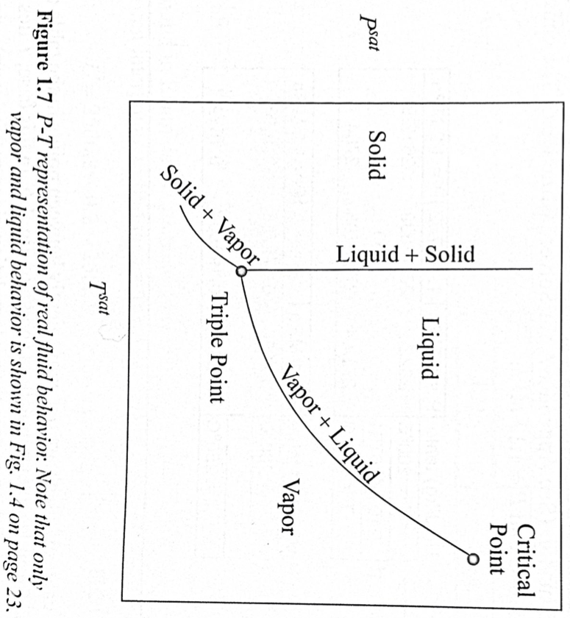
Phase Behavior for Single Component, C = 1
Water for example.
F = C – P + 2

Slide 25
Gibbs Phase Rule
F = C – P + 2
F free parameters
C components
P phases
So for saturated water vapor we have one component, two phases and one free parameter. That is if T is known we know the vapor pressure. If we know the pressure we know the temperature.
For supersaturated steam we have one component, one phase and we can vary P and T and these will determine the specific volume or density, internal energy, enthalpy, etc.

Slide 26
Gibbs Phase Rule
F = C – P + 2
F free parameters
C components
P phases

Slide 27
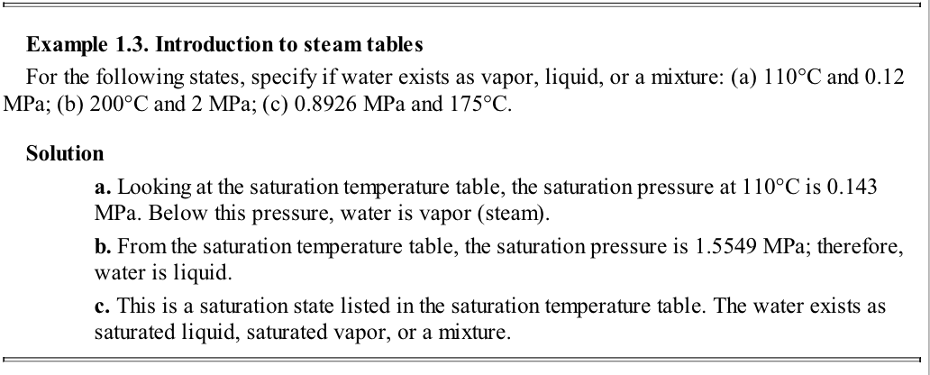

Slide 28
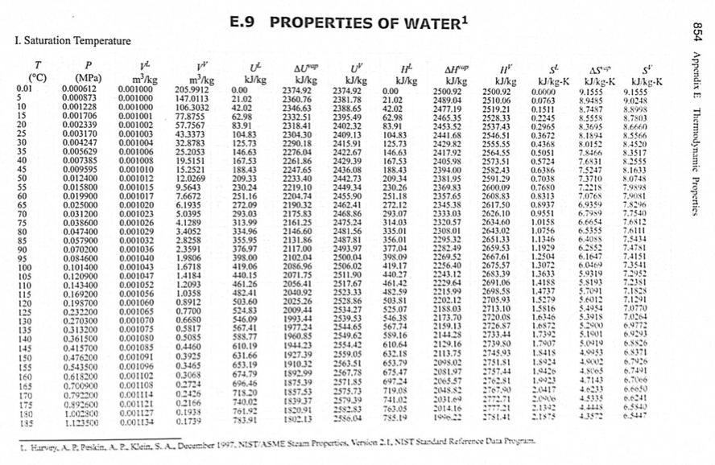
Steam Tables

Slide 29
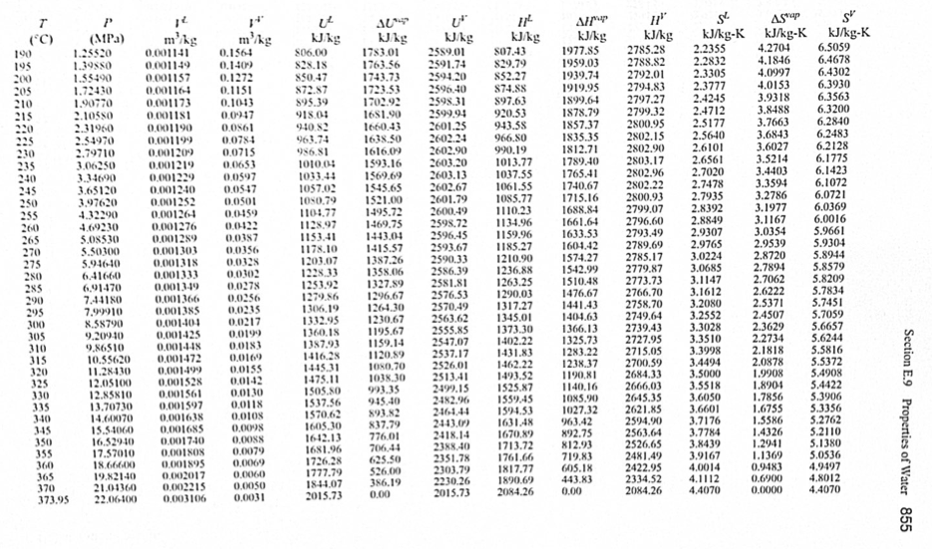

Slide 30
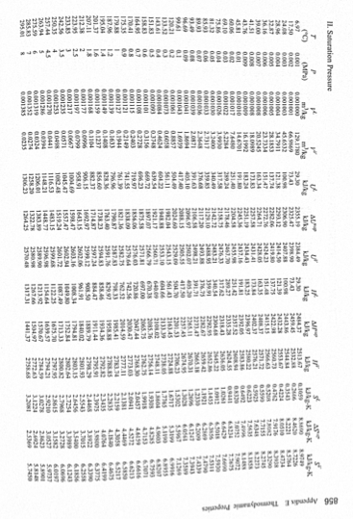

Slide 31
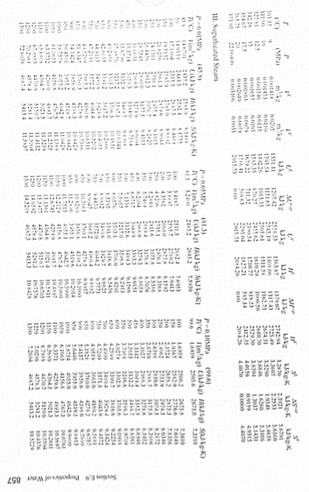

Slide 32
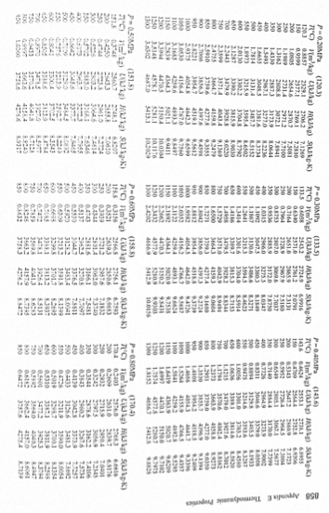

Slide 33
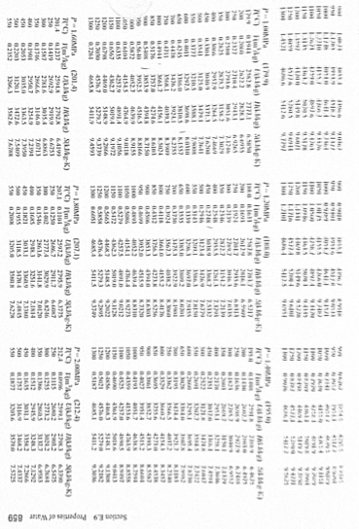

Slide 34
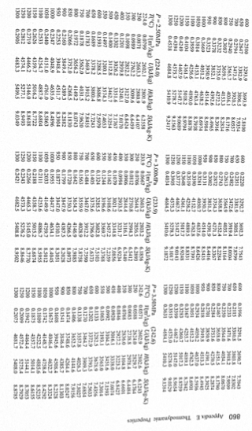

Slide 35
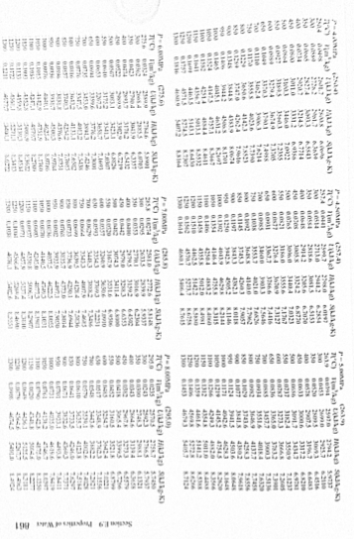

Slide 36
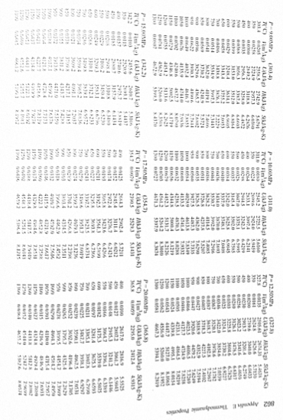

Slide 37
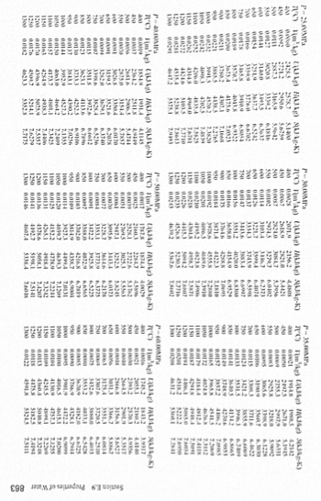

Slide 38
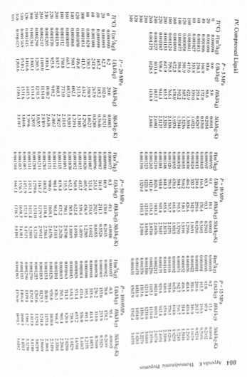

Slide 39
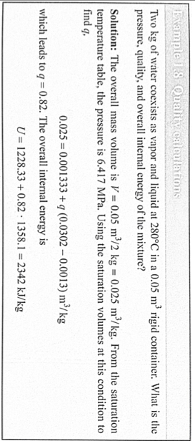

Slide 40
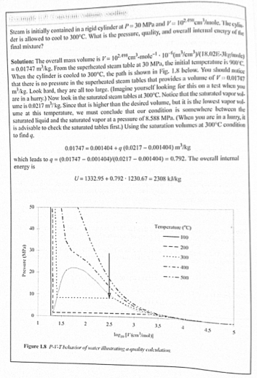

Slide 41
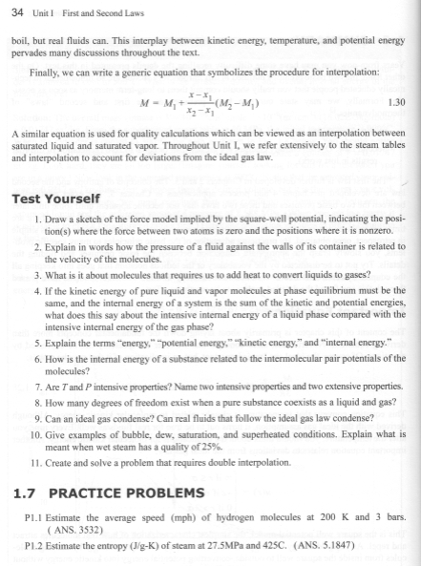

Slide 42
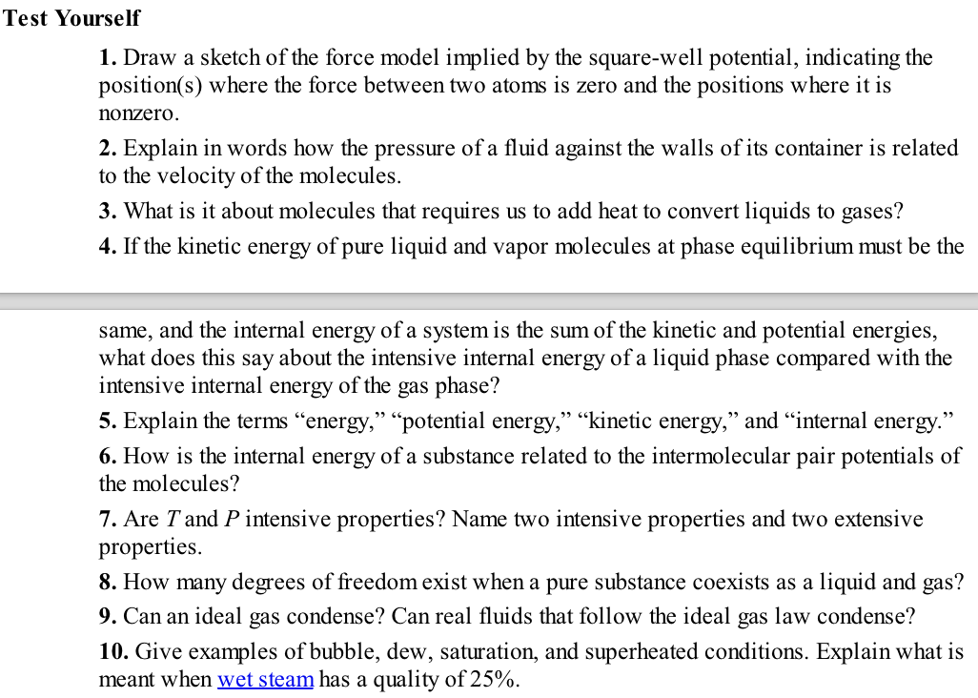

Slide 43
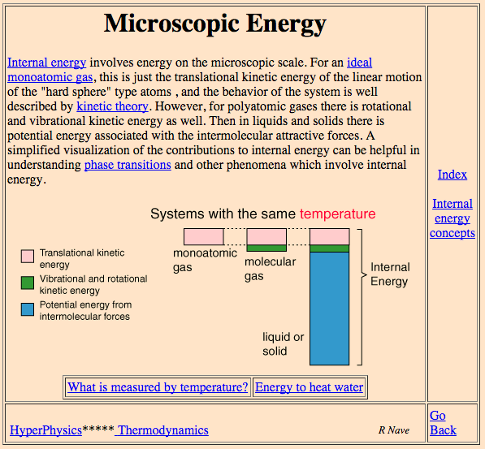
Question 4

Slide 44
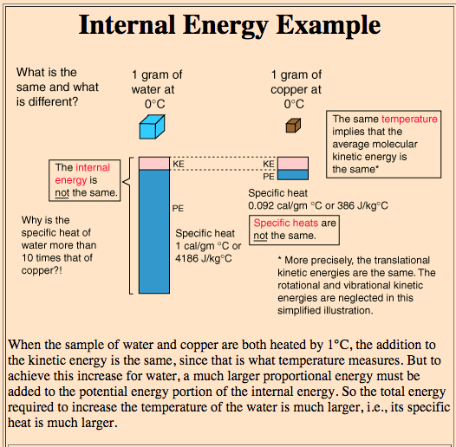

Slide 45
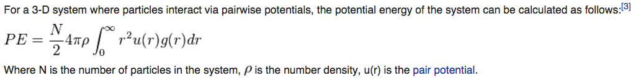
Question 6

Slide 46
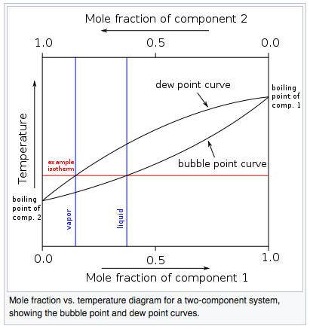
Question 10

Slide 47
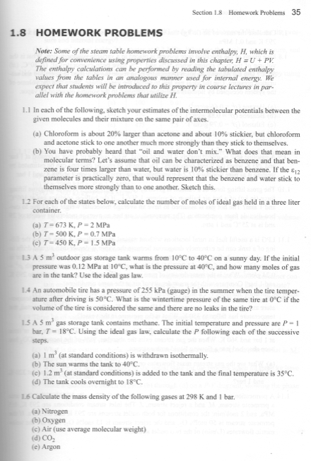

Slide 48
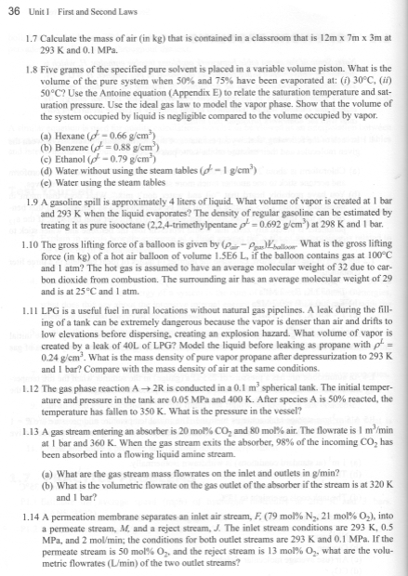

Slide 49
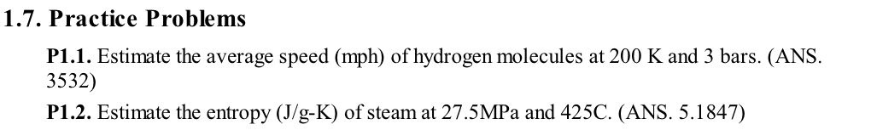

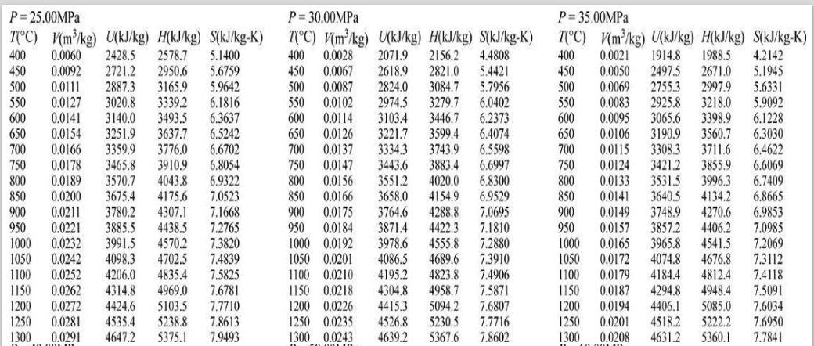

Slide 50
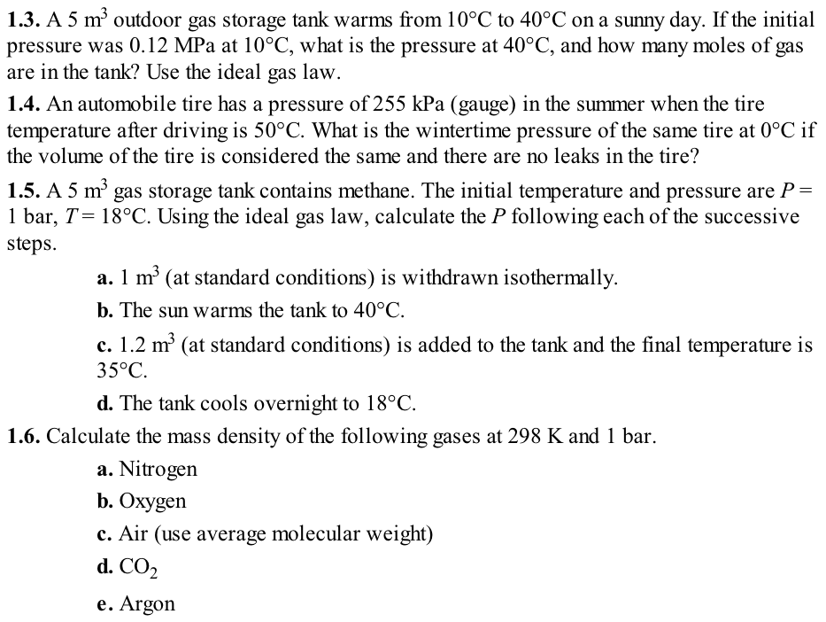

Slide 51
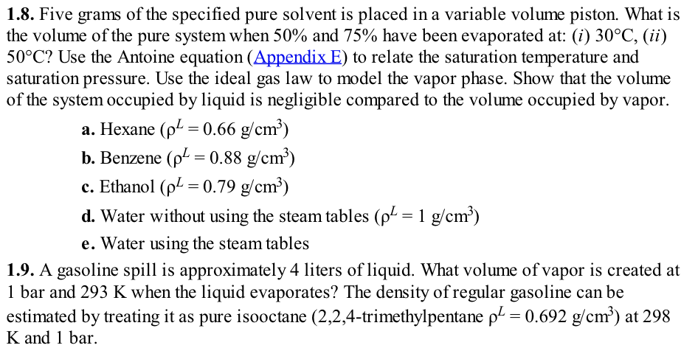

Slide 52
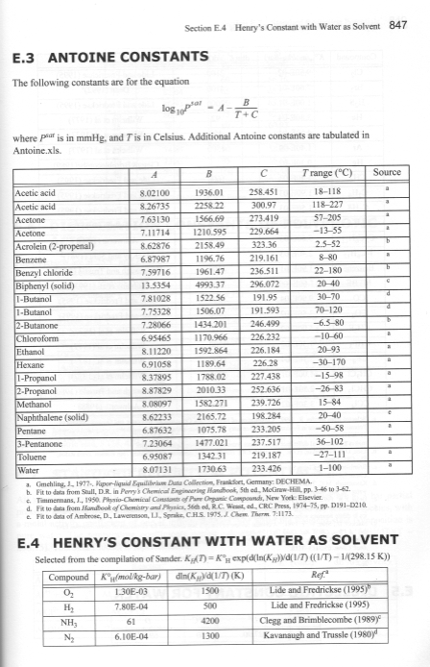

Slide 53
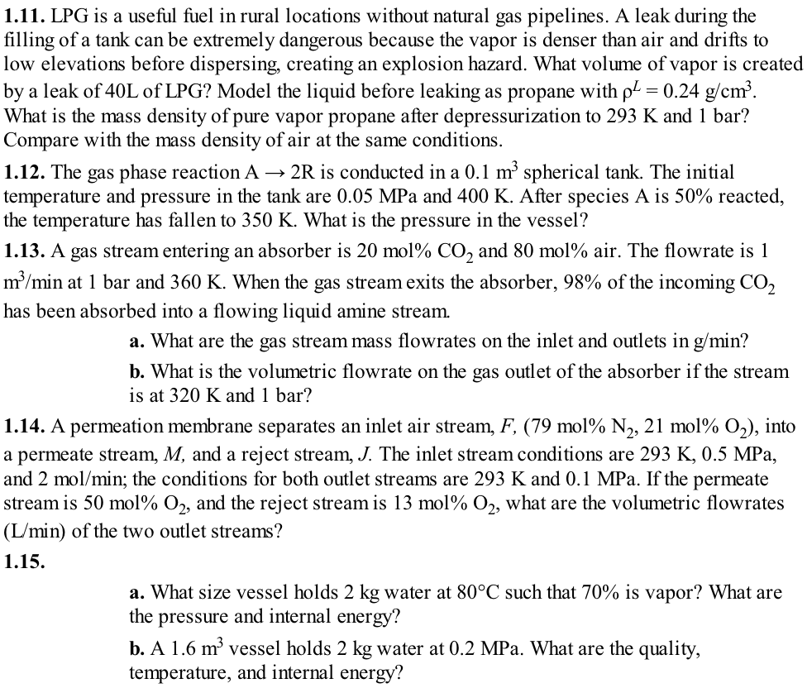

Slide 54
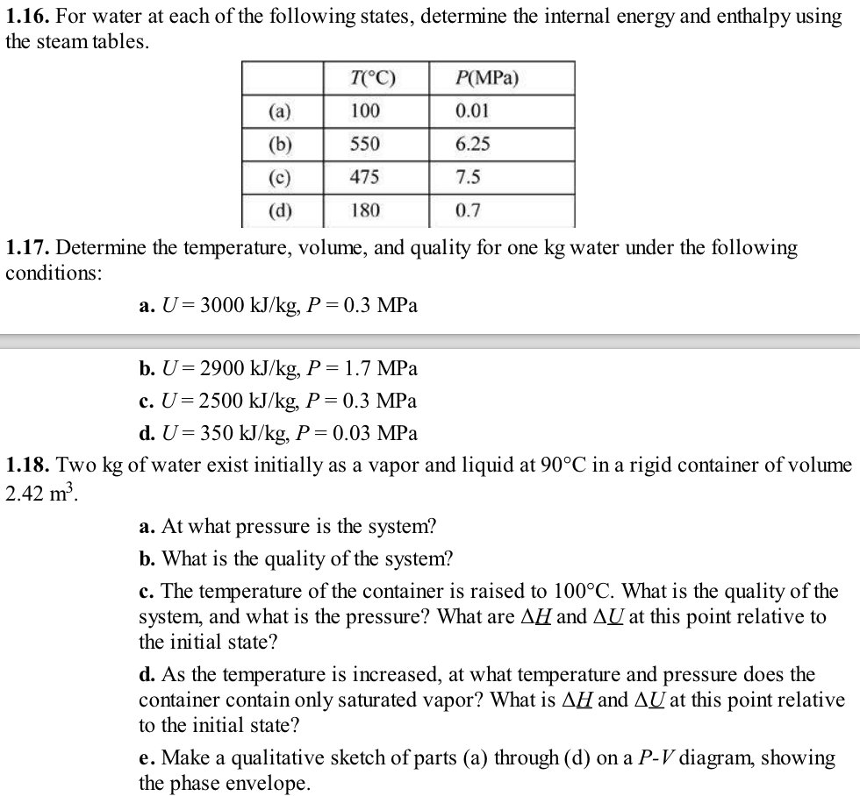

Slide 55
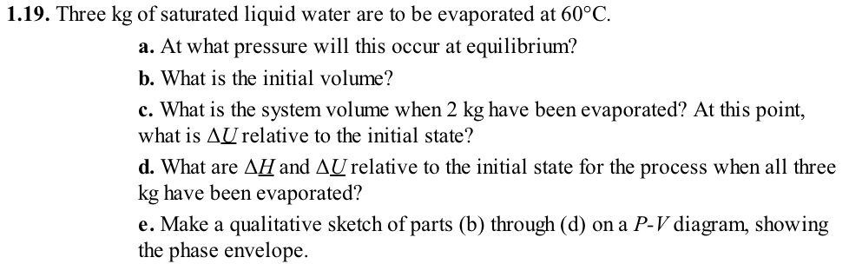

Slide 57
